Slide 1
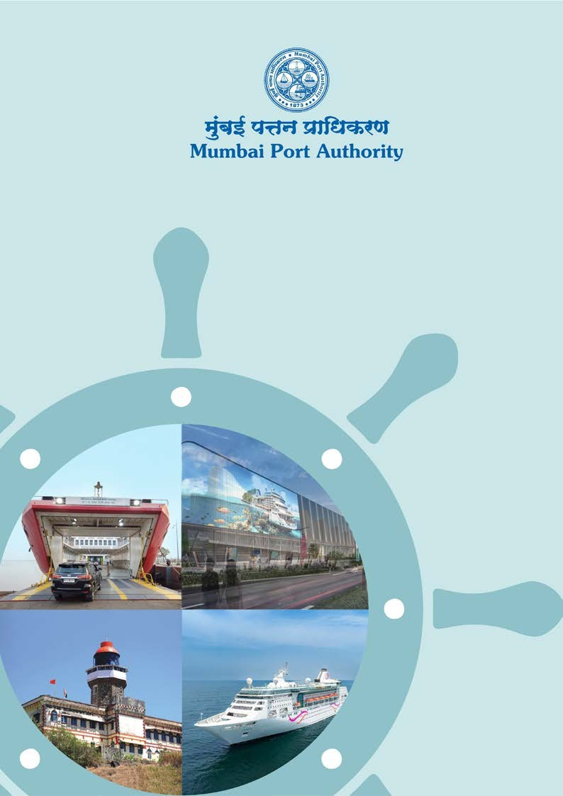
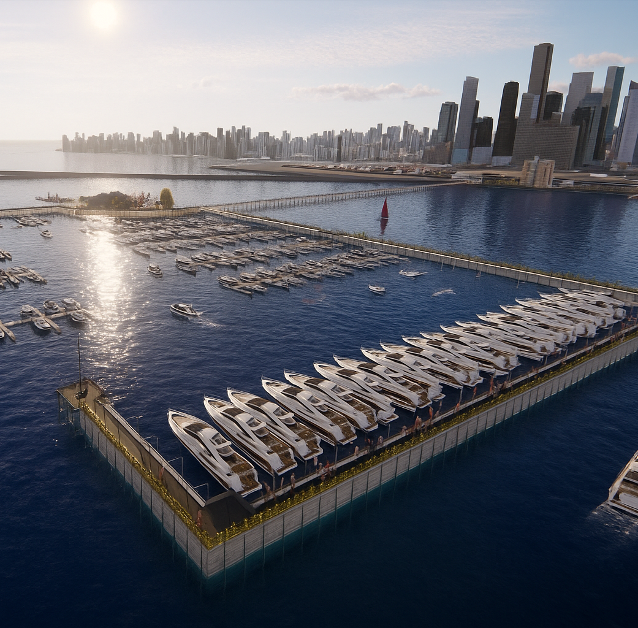
Ministry of Ports Shipping and Waterways, Government of India
MUMBAI MARINA
INDIA’s GLOBAL DESTINATION

Slide 3
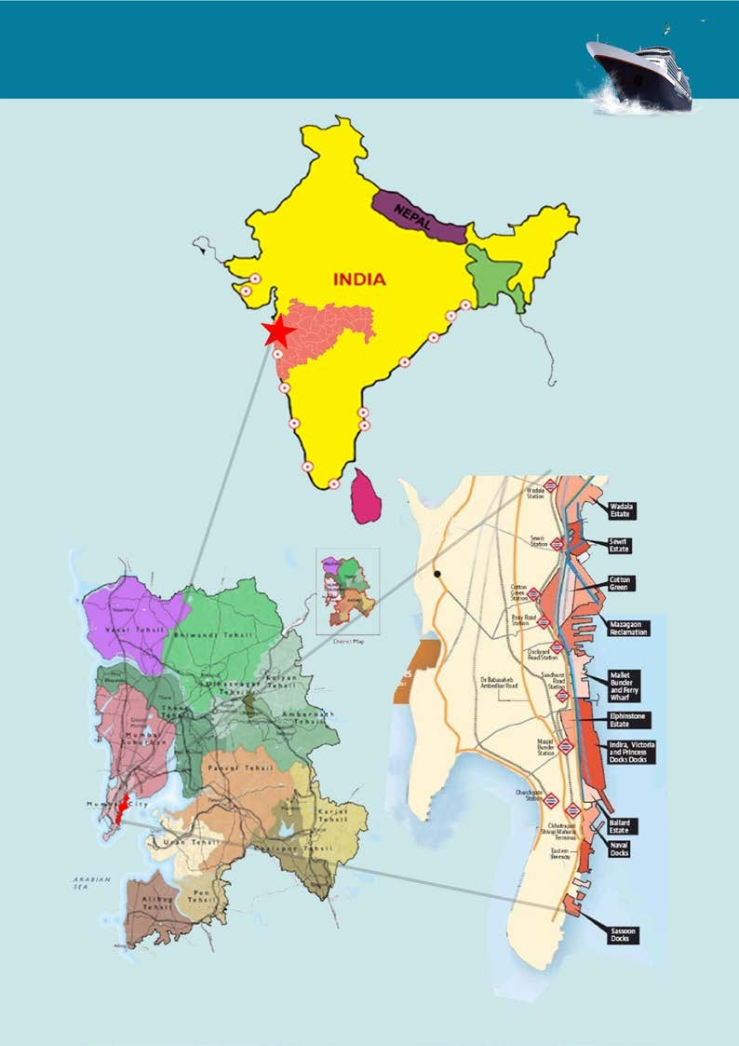
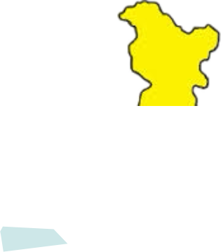

MAJOR PORTS OF
INDIA
PAKISTAN
CHINA
KANDLA VADHINAR
BANGLA DESH
MUMBAI
NHAVA- SHEVA
(J.N.P.A)
KOLKATA HALDIA
PARADEEP
VISAKHAPATNAM
MAYANMAR
ARABIAN SEA
MORMUGOA
ENNORE CHENNAI
BAY OF BENGAL
MANGALORE
COCHIN
TUTICORIN SRILANKA INDIAN OCEAN
Mumbai Metropolitan Region
Map showing MbPA Area

Slide 4
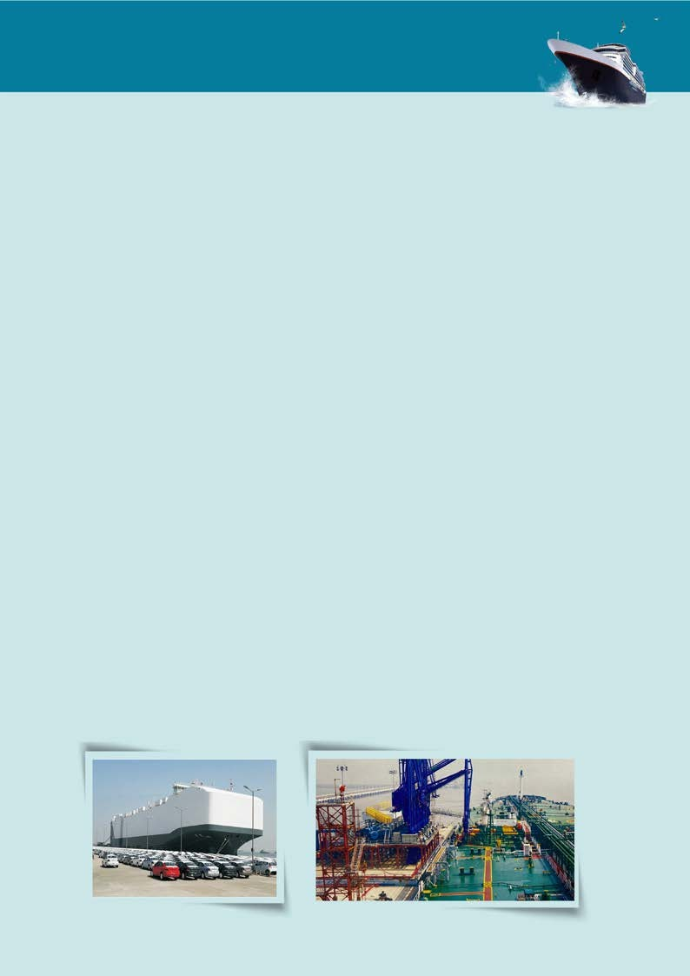
A. INTRODUCTION
Mumbai Port Authority, with its rich maritime legacy since its establishment as the Bombay Port Trust in 1873, has been a cornerstone of India's economic, cultural, and political evolution. Administered by the Mumbai Port Authority (MbPA), an autonomous body under Ministry of Ports Shipping and Waterways, Governemnt of India, the port has played a pivotal role in shaping the Mumbai Megapolis, serving as a vital gateway to the nation and driving its growth and prosperity.
While the port primarily focused on handling bulk cargo, it has adapted to changing shipping trends by developing infrastructure to support modern cargo handling. Mumbai Port specializes in Break Bulk, Project Cargo and Liquid bulk cargos such as Crude, POL, Chemicals and LPG cargos.
Beyond trade, Mumbai Port has been central to the industrial development of Western India, influencing the lives of Mumbai’s citizens in diverse spheres such as art, culture, commerce, and connectivity. Its continuous efforts to adapt to the evolving needs of maritime trade have solidified its position as a key player in the global shipping ecosystem.
Once regarded as India’s premier port, Mumbai Port remains a vital contributor to the nation’s maritime industry. Today, it handles approximately 8.18% of the country’s sea-borne trade amongst major ports and accounts for 19% of the POL traffic, underscoring its strategic importance.
Automobile Hub Export terminal
Fifth Oil Berth

Slide 5
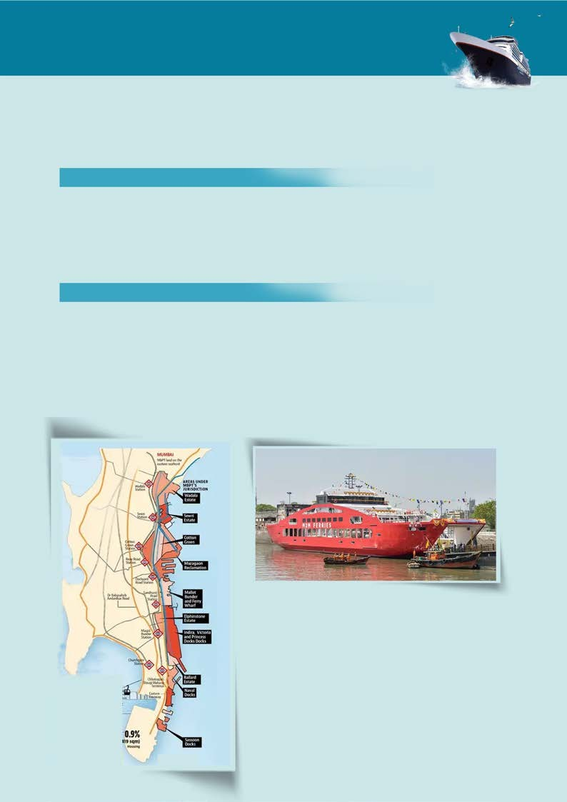
B. Unique Selling Proposition (USP) of Mumbai Port
Mumbai Port Authority (MbPA) is a premier gateway to India's economic and logistical landscape, distinguished by its financial robustness, extensive facilities, strategic location, and diverse operational portfolio.
STRATEGIC LOCATION
Centrally located along India’s western coastline, Mumbai Port facilitates seamless connectivity to domestic and international trade routes.
Proximity to economic hubs and industrial zones further enhances its logistics advantage.
WATER AREA & ESTATE MANAGEMENT
Total Water Area: 400 sq. km, supporting a vast range of maritime activities.
Land Assets: 944 Ha with 3,000 tenants, including commercial and residential leases.
Eastern Waterfront Development: Emerging as a mixed-use hub with RoPax and domestic cruise terminals.
Area - 6,000 Sq.M. (approx.)
Dedicated berthing area is approximately 100 m
Approximate capacity - 120 cars and 18 bus/truck
Travel time between Mumbai to Mandwa reduced by 2.5 hrs
Passenger capacity - 2.5 to 3 lakh per annum

Slide 6
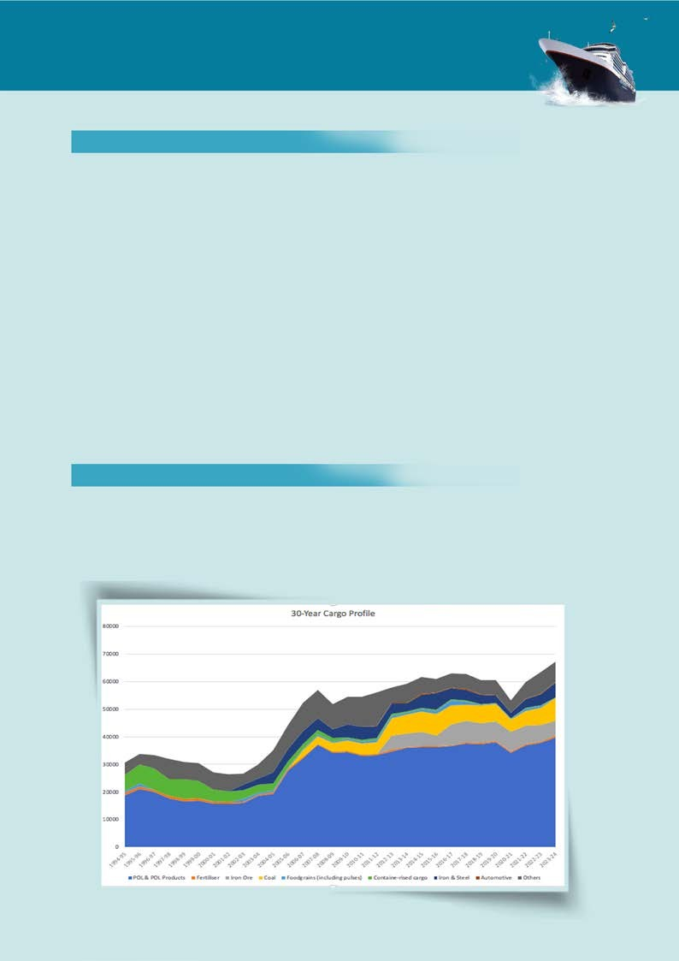
B. Unique Selling Proposition (USP) of Mumbai Port
III.COMPREHENSIVE INFRASTRUCTURE
Berths: 37 berths (33 self-operated, 2 on PPP, 4 for ship repair), catering to diverse cargo needs.
Specialized Terminals:
Marine Oil Terminal: For POL products at Jawahar Dweep.
Chemical & Gas Terminal: For liquid and gaseous chemicals at Pir Pau.
Hughes Dry Dock: A state-of-the-art ship repair facility operated by CSL.
Ro-Ro Facility: Dedicated automobile handling infrastructure.
Mumbai International Cruise Terminal: A modern hub for luxury cruise liners.
Fishing Harbors: Sassoon Dock and Mallet Bunder, vital for Mumbai's fishing industry.
IV.IMPRESSIVE CARGO PROFILE (2023-24)
Total Cargo Traffic: 68.63 MT, for FY 2024-25
Cargo Composition:
60% POL and POL Products.
20% Lighterage cargo, showcasing specialization in bulk handling.

Slide 7
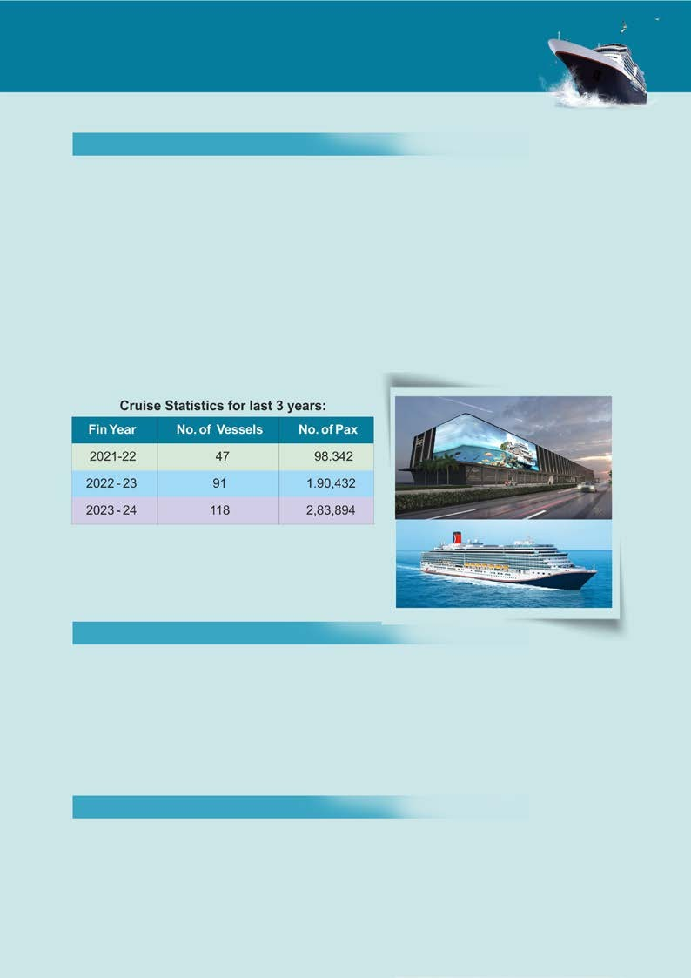
B. Unique Selling Proposition (USP) of Mumbai Port
V.THRIVING CRUISE TOURISM (2023-24)
Domestic Cruises: 118 calls, serving 2,83,894 passengers.
International Cruises: 27 calls, catering to 36,874 passengers.
The Mumbai International Cruise Terminal, complemented by domestic cruise operations, reinforces the port's standing as a tourism hub.
Mumbai Port Authority is developing the prestigious Mumbai International Cruise Terminal at Ballard Pier over a 40,000 Sq.m. space with state-of-art passenger amenities for handling 1 million passengers and 500 ships per annum. Renowned International & Domestic Cruise Liners have made port calls or home ported their ships from Mumbai.
VI. DISTINCTIVE FEATURES
Diverse Operations: Cargo, tourism, fishing, Ro-Ro, and ship repair.
Urban Integration: Eastern Waterfront links the port to Mumbai, boosting accessibility and growth.

Slide 8
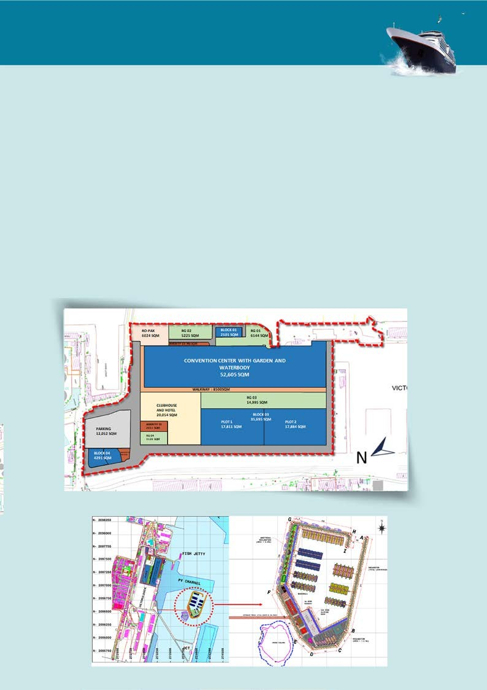
C. Marina and Eastern Waterfront Development
The Marina and Waterfront Development at Mumbai Harbour is a transformative initiative by the Mumbai Port Authority (MbPA) to create a world-class commercial and recreational hub. The project includes a Marina near Cross Island, a 22-hectare commercial waterfront at Prince’s Dock, and an International Convention Center. The Marina will feature modern docking facilities, maintenance services, fueling stations, and leisure amenities like cafes, restaurants, and boutique retail outlets, along with ferry connectivity to the mainland. The commercial waterfront at Prince’s Dock will focus on premium office spaces, retail hubs, and landscaped public spaces, creating a vibrant destination for businesses and visitors. The International Convention Center will serve as a state-of-the-art venue for global conferences, exhibitions, and cultural events, enhancing Mumbai’s status as a hub for business tourism.
International Convention Center and Commercial Development at Prince Dock
Marina Near Cross Island

Slide 9

C. Marina and Eastern Waterfront Development
Development of Yacht Marina at Cross Island, Mumbai Port
Purpose of the Project
The primary purpose of the Yacht Marina project is to establish Mumbai as a premier destination for yachting, addressing the increasing demand for modern berthing and maintenance facilities. The marina will accommodate 424 yachts. It aims to promote the yachting and tourism industries, create employment opportunities, and support leisure sailing and brief stays. By integrating state-of-the-art amenities, the project will position Mumbai as a hub for luxury maritime activities, fostering economic growth and international recognition in the leisure boating sector.
Project Cost Estimate
Mumbai Port has proposed an investment of $.39.21 million.
The Project includes the following:
Component | Specification / Details
Capacity | 424 Yachts
Floating Pontoons & Gangways | With guide piles for safe yacht berthing
Approach Trestle | 523m length
Service Platform | Includes: Electrical room, Car parking, Admin building, Customs & Toilets
Gangway Platforms | 5 Nos.
Boat Ramp | Located near the shoreline
Mumbai Port has invited bids on EPC contract for Marina wherein companies having experience in construction & design of Marina can apply.
The document can be downloaded under Tender No. ‘E.57/2025: Construction of Marina in Mumbai harbor’ available on www.mumbaiport.gov.in & www.eprocure.gov.in
Last date for Application : 20.11.2025

Slide 10
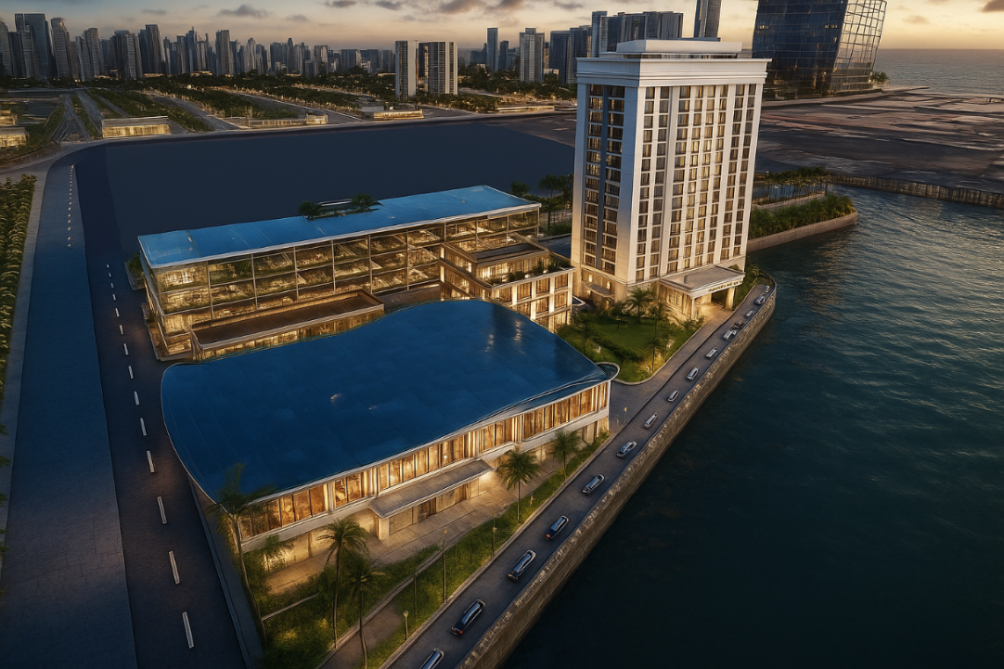
C. Marina and Eastern Waterfront Development
Opportunity for operation and management of Marina on a Revenue share Model
Become a part of an integrated marina facility management comprising construction and management of terminal building, star hotel, clubhouse, multi-level park parking, yacht parking facilities, recreation facilities, training school, repair facilities, F&B, etc., on a PPP mode
Be a part of the development of a landmark yacht tourism infrastructure facility in India. The operator has flexibility for planning the operation and management of the marina and tourism facilities
Facilities | Built Up Area (in sq.m)
Luxurious Hotel | 27,000
MLCP & Tourism Bussiness Centre | 32,000
Yachts Club House | 4,000
Terminal Building | 3,162
Sailing School | 1,060
The project will have Exclusive Yacht Repair and Stacking facility
Tender will be invited Shortly
On shore Development of Marina Activities

Slide 11
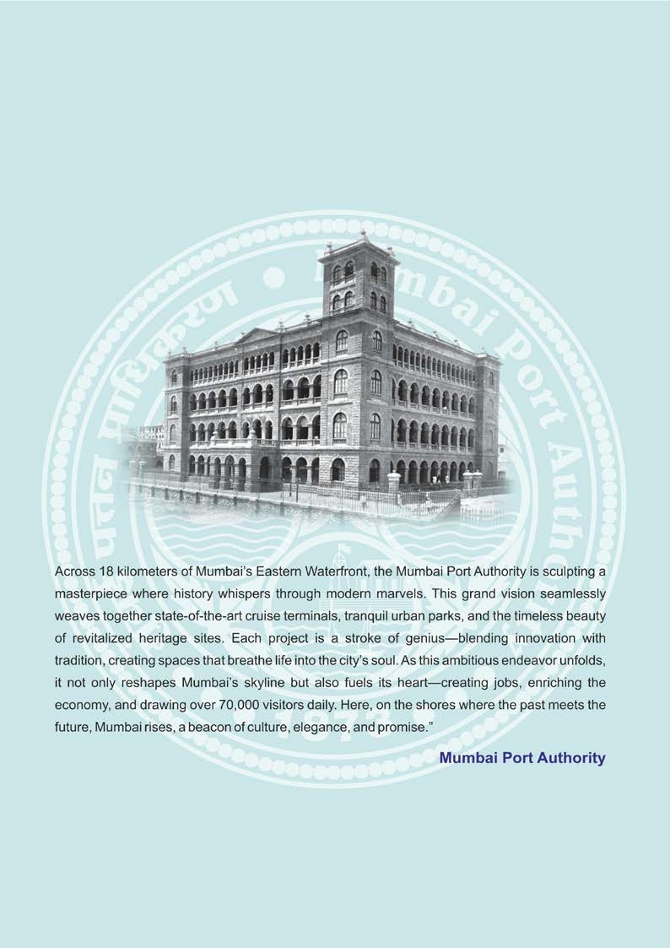

Slide 12
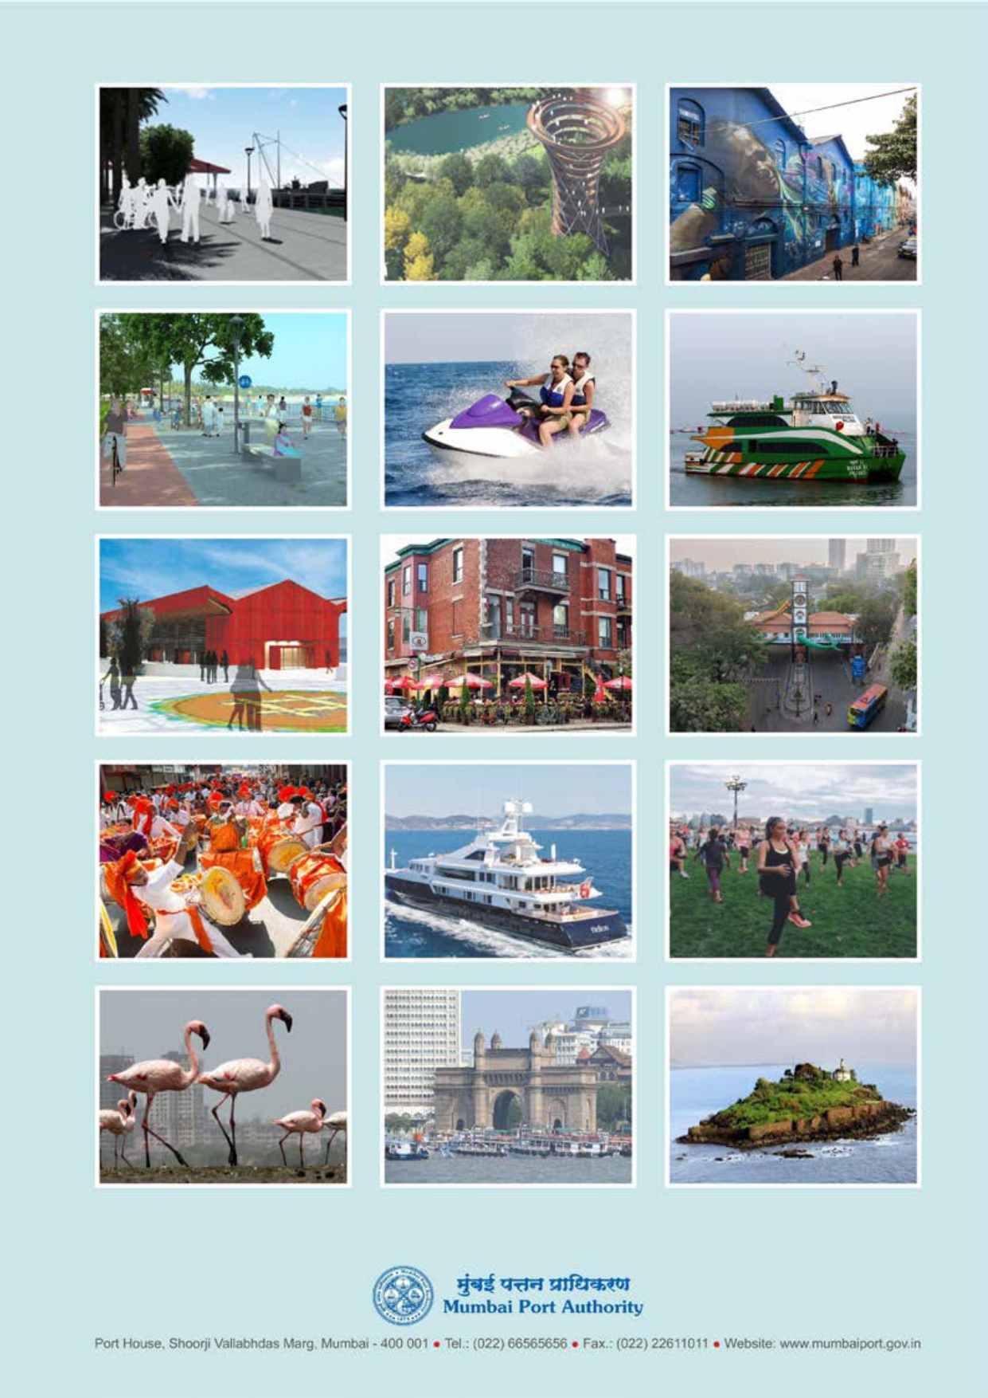
Location : Port House, Shoorji Vallabhdas Marg, Mumbai – 400 001 | Website: https://mumbaiport.gov.in

